Slide 1

CrowdFund
The Thirdweb Web3 Crowdfunding App aims to enable blockchain-based crowdfunding with transparent, secure, and decentralized funding processes. It leverages blockchain technology to allow creators to launch campaigns and receive funds in a decentralized manner, ensuring trust and transparency.
by: Govind Gupta Harsh Sharma Kanchan Sagar Kartikey Raghuvanshi

Slide 2

Project Abstract
Overview
Key Objectives
Approach
This project offers a Web3 crowdfunding platform using blockchain for secure and transparent fundraising.
To provide a decentralized environment for creators to launch campaigns and receive funding directly, fostering trust among backers.
Using Thirdweb tools, Solidity, and Next.js, the app integrates blockchain-based smart contracts with a responsive front end, delivering a smooth user experience.

Slide 3
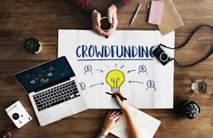
Project Goals and Objectives
Decentralization
1
To build a decentralized crowdfunding platform leveraging blockchain technology, eliminating intermediaries.
2
Transparency
Provide transparency by using smart contracts to handle funds, ensuring campaigns are secure and trustless.
Immutability
3
Utilize blockchain for immutable transaction records.

Slide 4
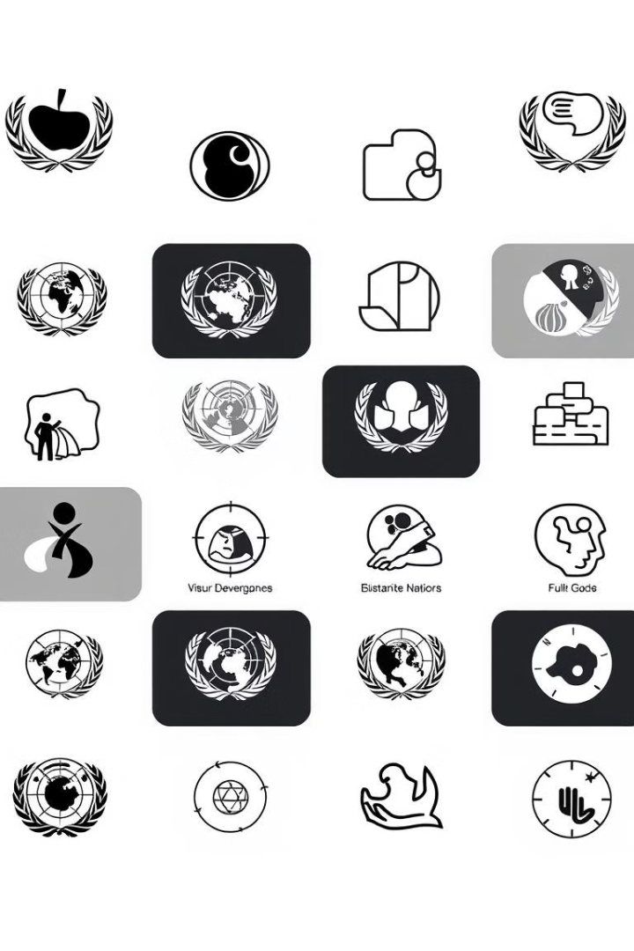
Alignment with UN Sustainable Development Goals (SDGs)
SDG 8: Decent Work and Economic Growth
SDG 9: Industry, Innovation,
and Infrastructure
SDG 10: Reduced
Inequalities
SDG 17: Partnerships for the Goals

Slide 5





Methodology and Approach
Implementing Blockchain
The project begins by setting up a blockchain environment using the Thirdweb platform, providing the foundation for decentralized applications.
Smart Contracts
Smart contracts are written in Solidity, deployed to manage campaign funding, contributions, and disbursements securely.
Interface
The frontend is developed using Next.js to create a dynamic and responsive interface, ensuring smooth interaction for users across devices.
Wallet Integration
Wallet integration, particularly using MetaMask, is implemented for secure transactions, allowing users to easily contribute funds to campaigns.

Slide 6




Expected Outcomes and Impact
Transparency
The main expected outcome is to create a transparent and decentralized crowdfunding platform where contributors and creators can trust the system’s integrity.
Trustless
The project aims to disrupt traditional crowdfunding platforms by reducing reliance on intermediaries.
Secure
By making use of blockchain, the system will offer secure, immutable records of all transactions, enhancing accountability and trust within the crowdfunding ecosystem.

Slide 7

Key Project Deliverables
Smart Contract Development
and Audits
Develop secure, transparent smart contracts to handle contributions, fund management, and fund release.
Crowdfunding Campaign
Launch and Marketing
Successfully launch the crowdfunding campaign with robust community engagement and marketing strategies.
Project Platform and
User Interface (UI)
Develop a user-friendly platform that enables contributors to engage with the project.

Slide 8

Next Steps and Conclusion
1
Feedback
2
Scalability
Collect and analyze user feedback to continuously improve the platform’s features and user experience.
Enhance the platform's capacity to handle more users and transactions without compromising performance.
3
Integration
Plan future integrations with other blockchain platforms or tools to expand functionality.

Slide 9
THANK YOU

